Slide 1
XX00BH18-3427
Innovation Project
Business Planning 3

Slide 2
16.02.2023 Agenda
13:00 Introduction to this weeks task.
14:00 - Review of product/sprint backlog and teamwork
Please, submit a screenshot of your backlog to oma.

Slide 3
2.3.2023 Agenda
13:00 – 14:00 Introduction to this weeks task, preparing sales pitches, status report etc.
14:00 - Steering groups

Slide 4
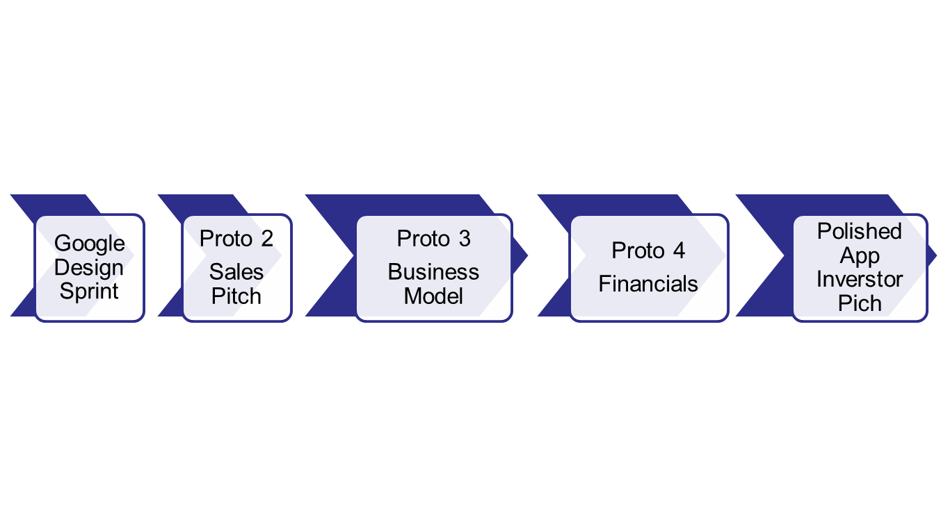
5 Development Sprints
January
February - March
April
May
Presentations to partner at the end of every sprint

Slide 5
Business planning tasks
Period 3:
What is your business? + draft minimum viable product (product backlog)
Customer segments (who would pay for the product and why?)
What will be your business model and earnings logic?
Sales pitch
Period 4:
Long term business roadmap
Financial plan (worst case, base case, best case)
Business validation

Slide 6
Sales Pitch and Demo (5 min + 5 min)
Draft to be shown in the steering group 1.3.2021
Dress rehearsal 8.3. 9 - 10
Sales pitch presentations 8.3. 14 - 15.

Slide 7
How to make a sales pitch?
Define a concrete target for your pitch like next meeting, meeting with the CEO...
Define your target audience (in real life you do not have this luxury…) and keep it in mind when creating the presentation.
While preparing the presentation, list down the questions you might be asked and find the answers.
Practice your pitch. Be prepared to present your idea in shorter time, without slides etc.
Use concrete examples when describing the problem.
For five minutes maybe five slides would be ok (depends on the presenter though).
Some food for thought: https://mailshake.com/blog/sales-pitch-examples/

Slide 8
One possible sales pitch script
Present your team
Opening
Present the problem
Describe how your product/solution will solve customer’s problem
Demo
Benefits&summary, agree on next actions
If possible, tie the end of presentation to the begining

Slide 9
Slides for the sales pitch
Should not be too crowded, but should still contain your main messages (it may be the slides are distributed to people who were not present at the meeting)
DO NOT WASTE the slide headlines, use them for your main message.
Use pictures, screenshots and diagrams where appropriate.
If possible include a demo (even just a clickable one) as it increases your credibility.
Make also a recorded version of the demo that you can use if on-line fails.

